Slide 1


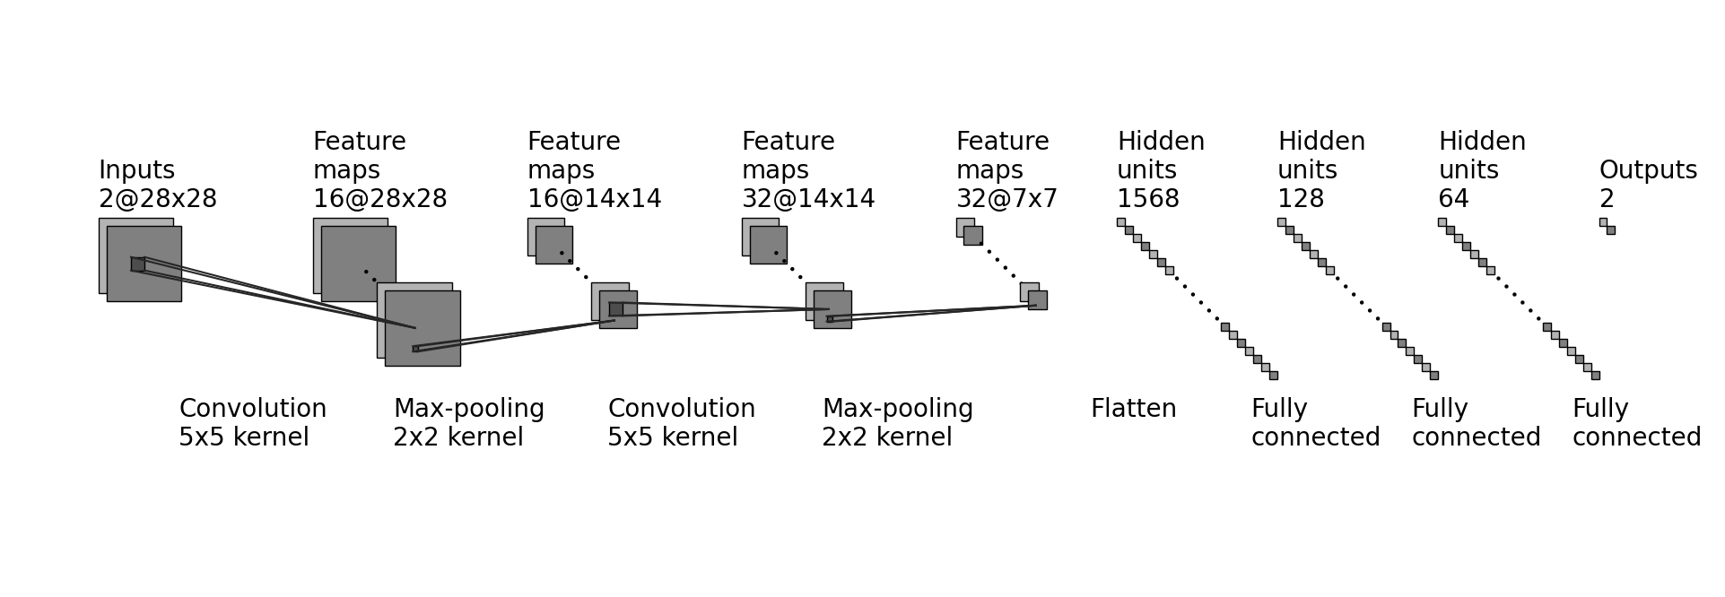
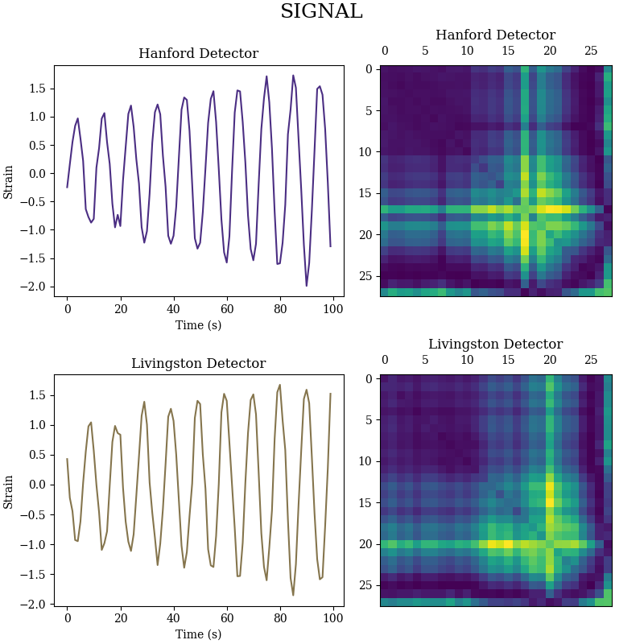
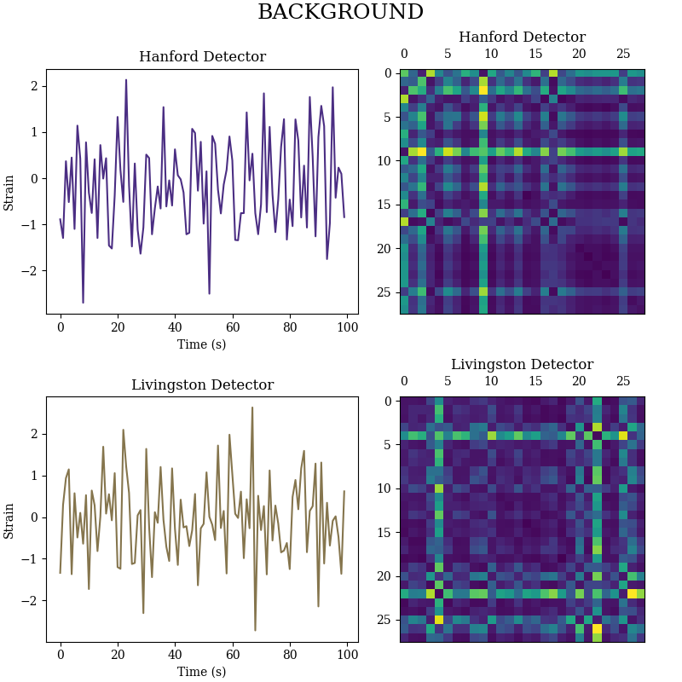
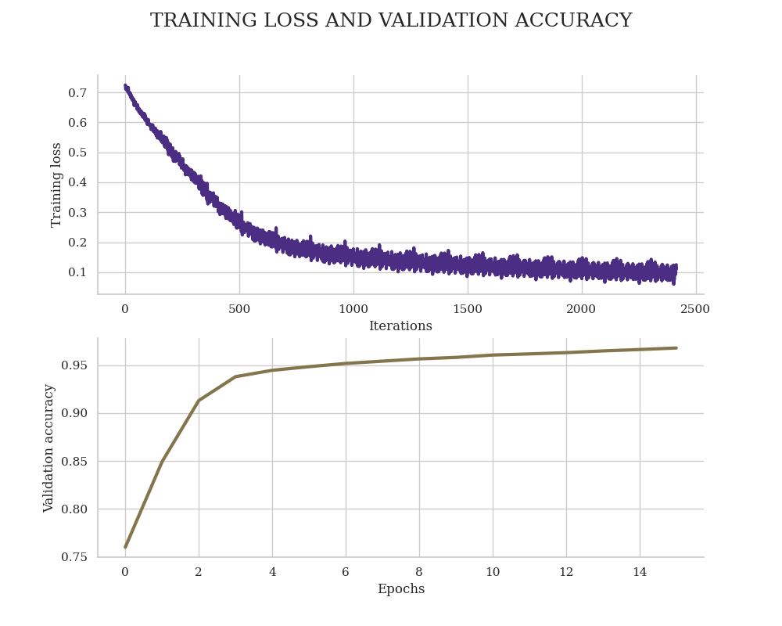
UNRAVELING GRAVITATIONAL RIPPLES: NEURAL NETWORK CLASSIFICATION
Daniel Fredin^{1,2} , Cole Welch¹
¹ Department of Physics, University of Washington, ² Center for Experimental Nuclear Physics and Astrophysics, University of Washington
INTRODUCTION
CNN ARCHITECTURE
TEXT
TEXT
TEXT
RESULTS
METHODOLOGY
TEXT
TEXT
DATA PREPROCESSING
CONCLUSIONS
TEXT
References
[1] Yemini, E., Jucikas, T., Grundy, L. J., Brown, A. E., & Schafer, W. R. (2013). A database of Caenorhabditis elegans behavioral phenotypes. Nature methods, 10(9), 877.

